Slide 1
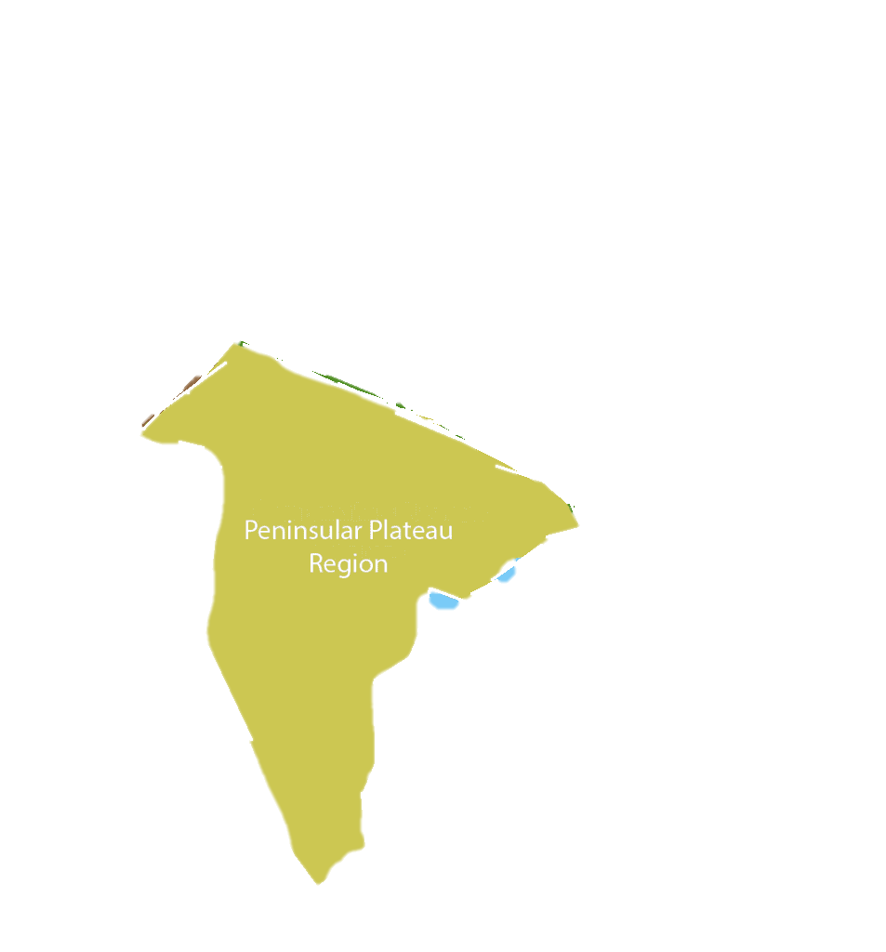
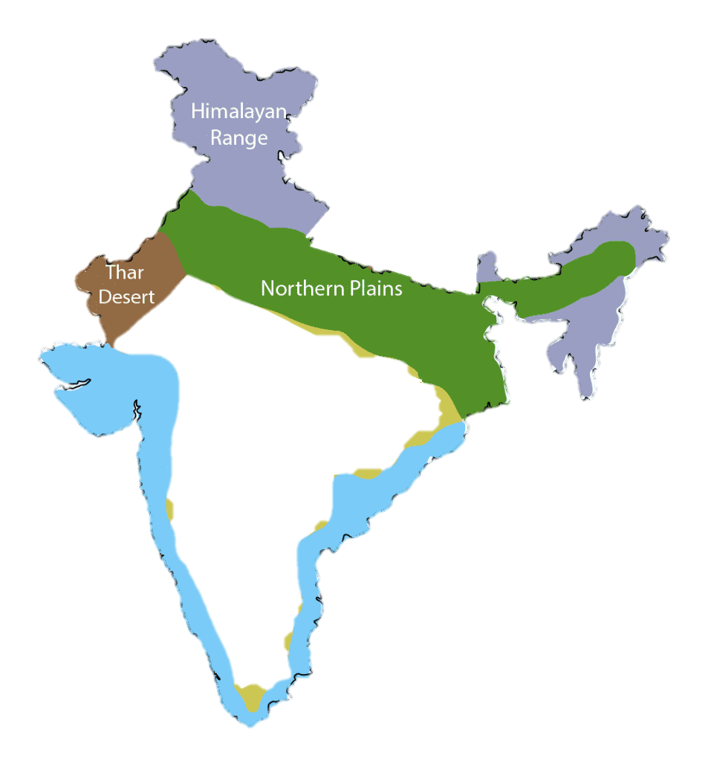
Virtual tour
Peninsular
Plateau

Slide 2
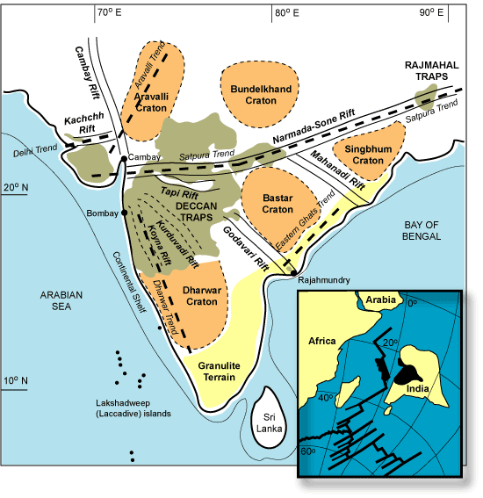
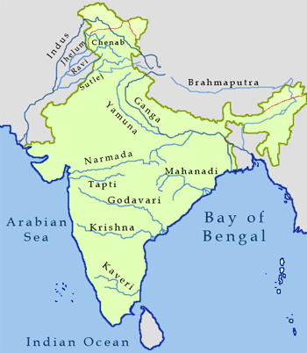
Peninsular plateau
A body or a piece of land enclosed on three sides by water, jutting out from a large body of a land.
Peninsular plateau is the oldest landform of the earth made of black soil (Volcanic eruption).
the plateau has broad and shallow valleys and rounded hills.
Narmada river and Vindhyan range divides the Deccan Plateau into two parts. Upper part is known as central highlands and lower part is known as Deccan plateau.

Slide 3
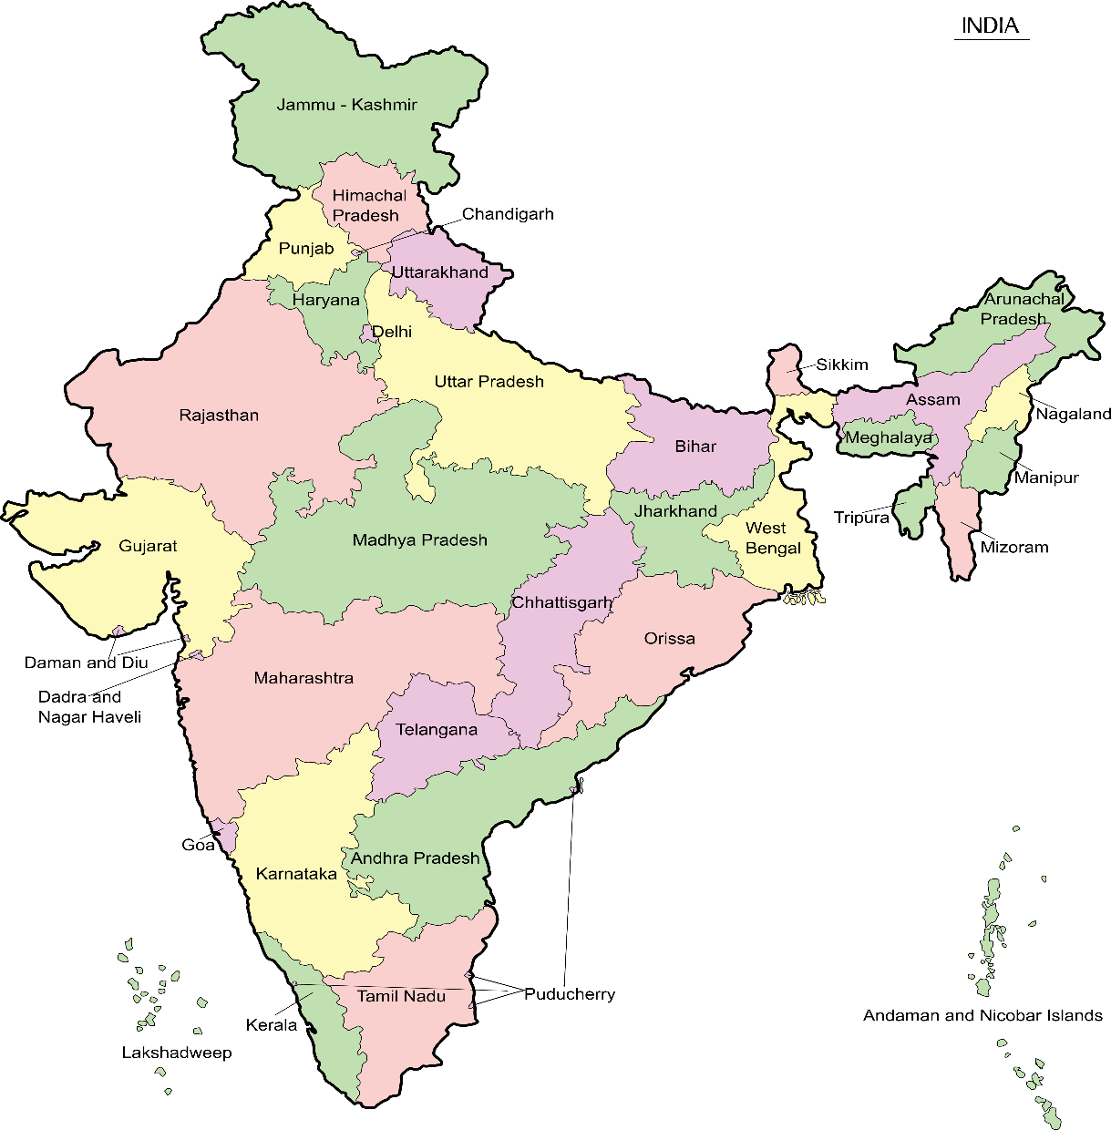
States COVERED IN PENINSULAR PLATEAU
States which lie in the Peninsular plateau
Madhya Pradesh
Jharkhand
Chhattisgarh
A Part of Orissa
Andhra Pradesh
Telangana
Maharashtra
Karnataka
Tamil nadu

Slide 4
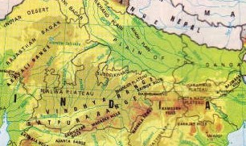
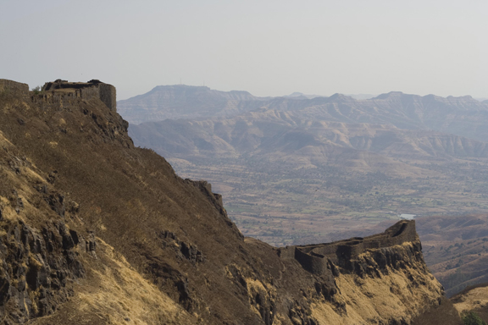
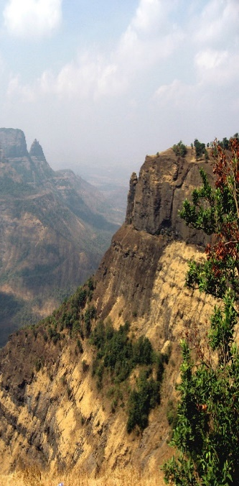
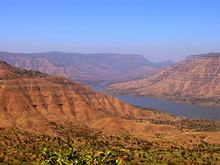
Central Highland
Central Highlands can be defined as a bio-geographic zone. These highlands have been formed by the disjunct ranges of the Satpura and Vindhya Hills.
They lie to the north of the Narmada river.
They are bounded by the Aravali mountans,Vindhya range,Malwa and Chotanagpur Plateau.
The Chota Nagpur Plateau mark its eastwards extension.
Its slope is from west to east.

Slide 5
Central Highland
4
1
The Malwa plateau
The Chhotanagpur Plateau
3
2
The Bundelkhand
The Baghelkhand

Slide 6
Deccan Plateau
The Deccan plateau is interesting to scientists (especially those who study rocks) because it was formed by lava flows. Millions of years ago, melted rock (lava) erupted from beneath the Earth's surface and spilled out over the ground. The lava spread out and hardened into a layer of rock on the surface.
They lie to the south of the Narmada river.
They are bounded by the Aravali mountans,Vindhya range,Malwa and Chotanagpur Plateau.
The Chota Nagpur Plateau mark its eastwards extension.
Its slope is from west to east.

Slide 7



Deccan Plateau
Did You Know ?
The Deccan Traps formed between 60 and 68 million years ago, at the end of the Cretaceous period. The bulk of the volcanic eruption occurred at the Western Ghats (near present-day Mumbai) some 66 million years ago.
1
The name Deccan is derived from Sanskrit word dakkhana dakṣiṇa (दक्षिण"south“) a the region located just south of North India.
The Deccan Trap
2
The Western Ghats
3
Eastern Ghats
4
An Extention of these plateau in also found in North East

Slide 8
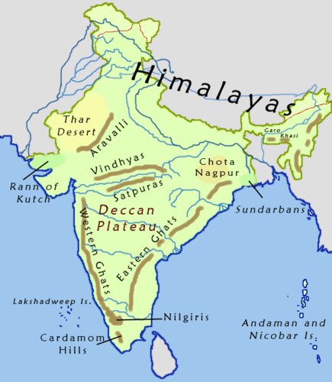
Western Ghats and Eastern Ghats
Western Ghats
Eastern Ghats
Continuous and can be crossed through passes only.
Higher than Eastern Ghats. The highest peak of Western Ghats is Anamudi (2659m).
They Stretch from tapi to the south of Nilgiri hills.
Lower than Western Ghats. The highest peak of Eastern Ghats in Mahengragiri(1501m)
They stretch from Mahanadi valley to the Nilgiri hills
Discontinuous .Irregular and dissected by rivers.

Slide 9

Contribution
Avlokita-Facts
Suhani - Pictures
Ashit – Making Quiz
Avani- Content
Ashit- Suggesting Editing Ideas
Bhavika – Editing And Formatting slides
All of the members - Narration

Slide 10



